Slide 1

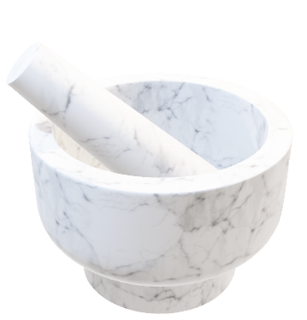

Web Technologies
Recipe Blog

Slide 2


Navigation Bar
Navbar Contents:
Logo
Navlinks –
Home
Categories
About
Dev Team

Slide 3
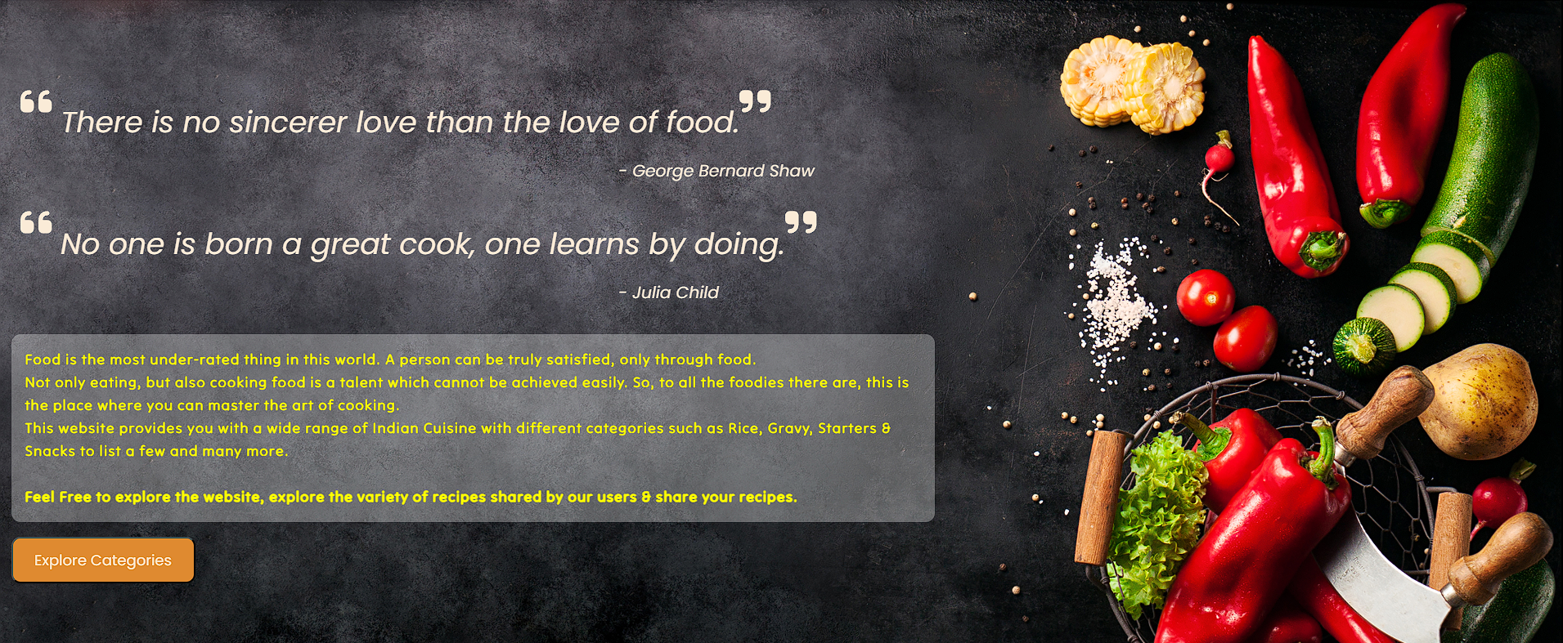
Home Page
A simple section with a button to explore the Categories section

Slide 4
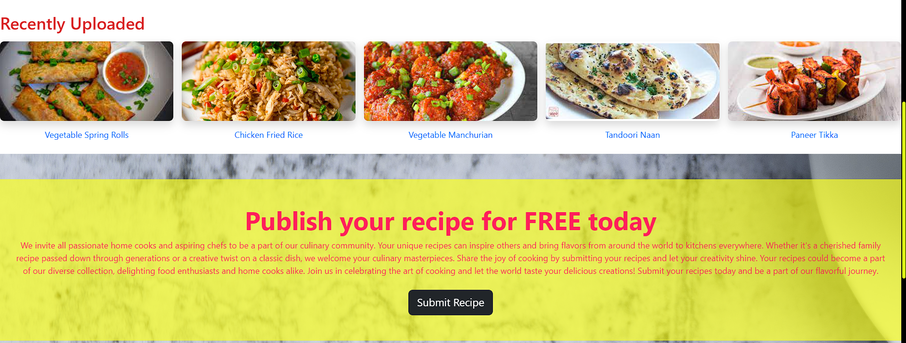
Home Page (continuation)
A continued part of the HOME page shows the section for the recent 5 recipes submitted in the website and another section from where the user can submit their own recipe

Slide 5
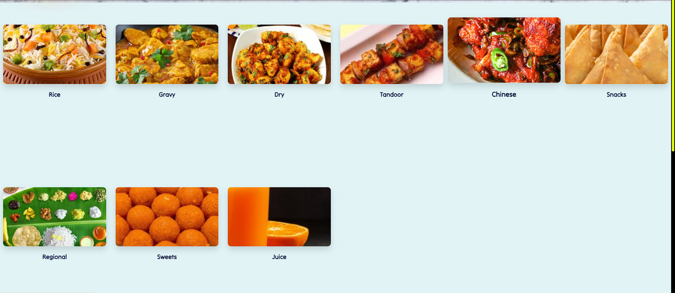
Categories
9 different categories (Indian Subcontinent)

Slide 6
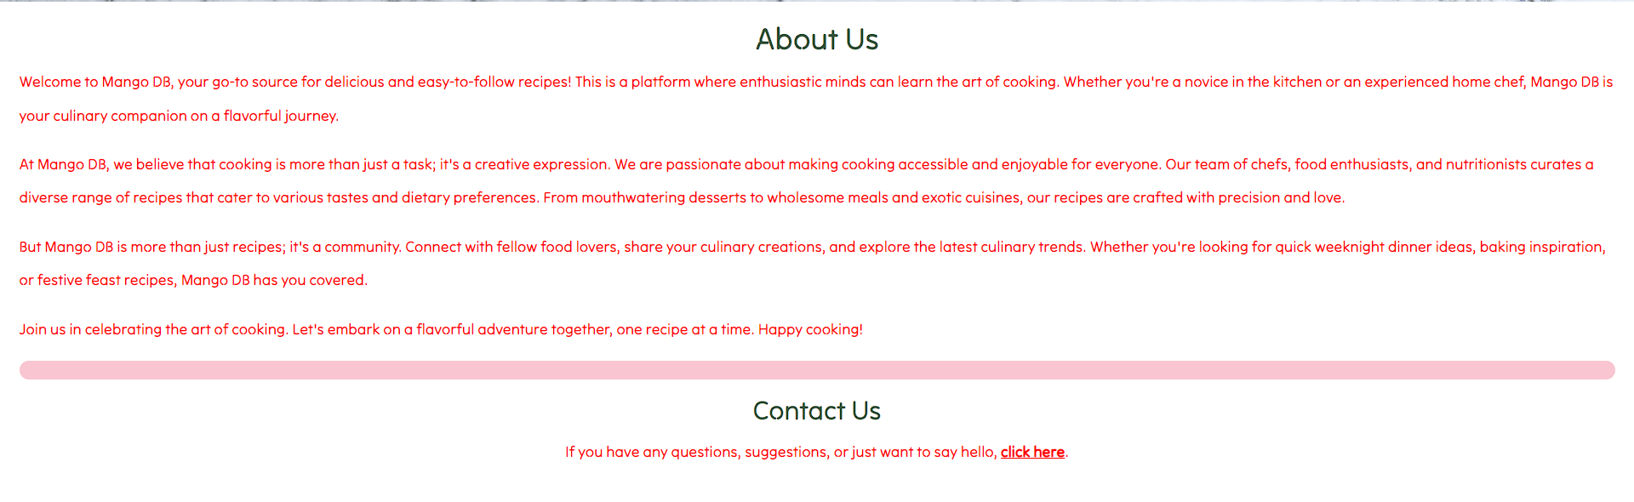
About Page
Describes the company & the objective of the website

Slide 7
The Team Page

Slide 8
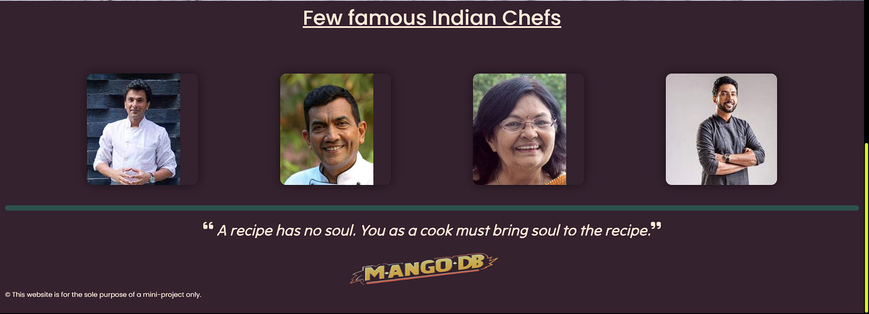
Footer

Slide 9
Thank You

